Slide 1

Introducing {workboots}
Generate prediction intervals from tidymodel workflows
Mark Rieke
2022-07-27
<link to slides>

Slide 2
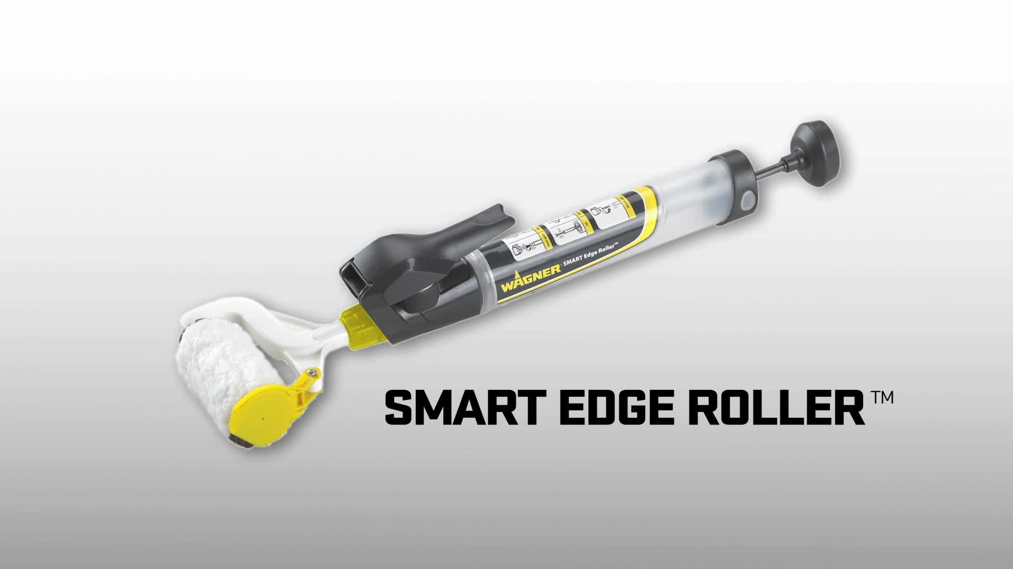

Slide 3
paint brush with bluetooth

Slide 4
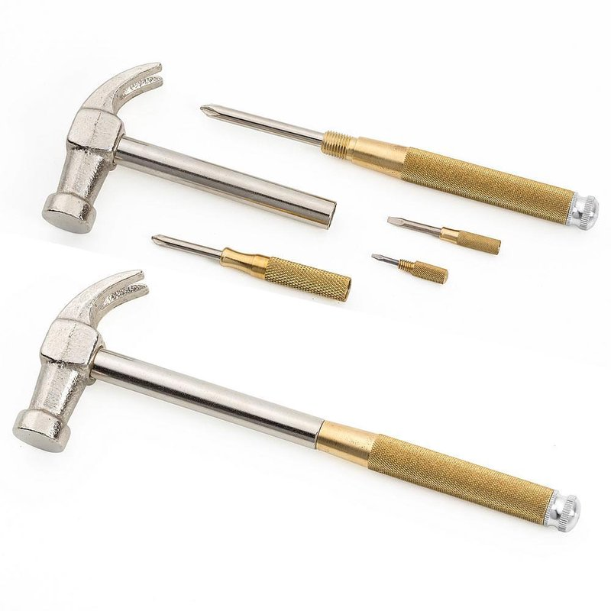

Slide 5
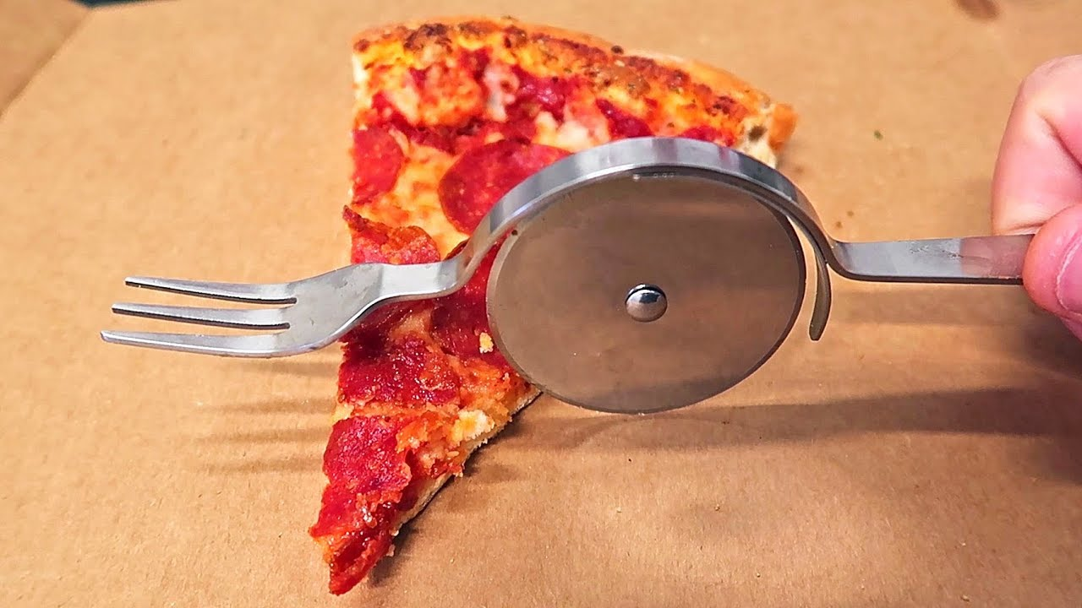

Slide 6
Kreg jig slide 1
Tool itself – specific tool, specific job

Slide 7
Kreg jig slide 2
Joining edges

Slide 8
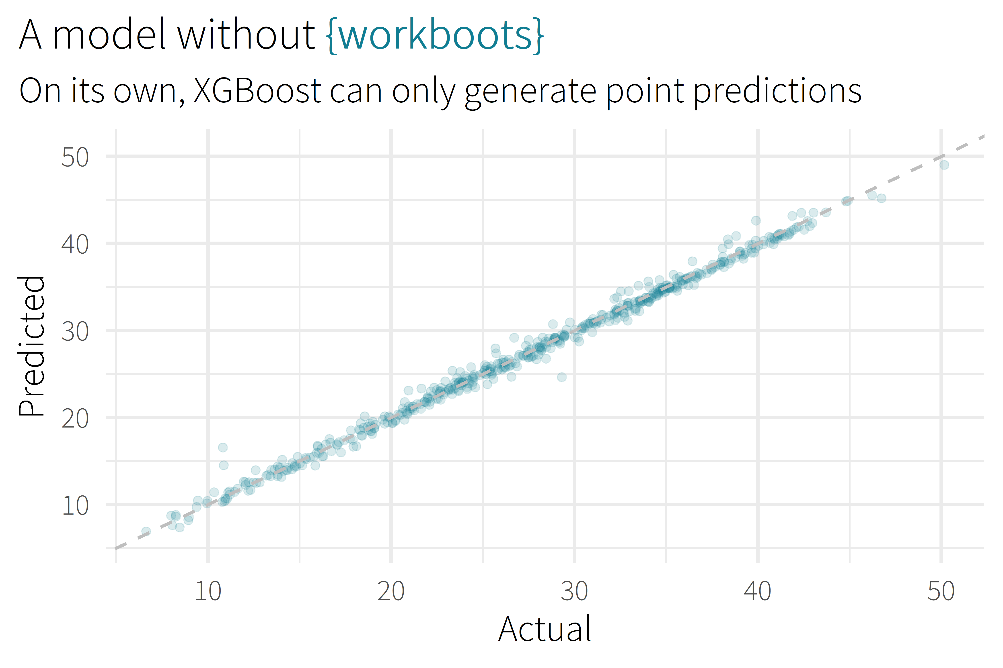

Slide 9
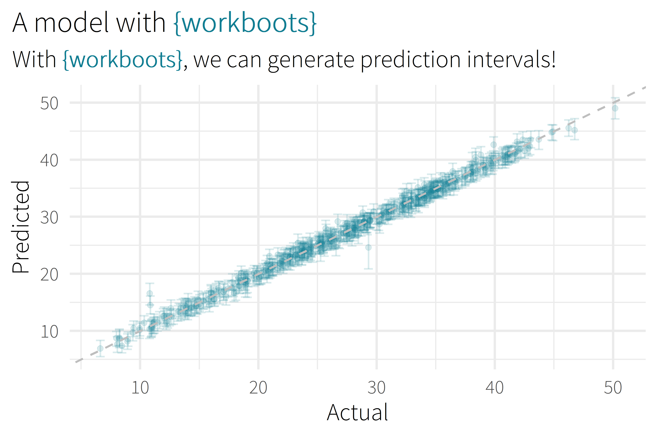

Slide 10

Motivation/Background

Slide 11
Package Overview

Slide 12
setting up a workflow
library(tidymodels)

Slide 13
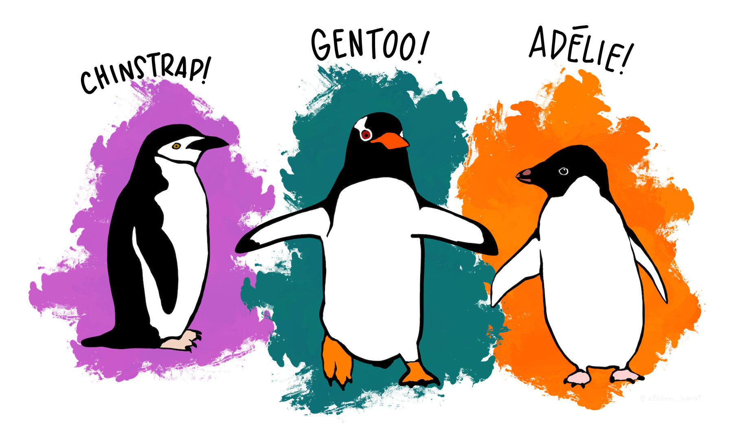
setting up a workflow
library(tidymodels)
# setup our data
data(“penguins”)
penguins <- penguins %>% drop_na()

Slide 14
setting up a workflow
library(tidymodels)
# setup our data
data(“penguins”)
penguins <- penguins %>% drop_na()
set.seed(123)
penguins_split <- initial_split(penguins)
penguins_test <- testing(penguins_split)
penguins_train <- training(penguins_split)

Slide 15
setting up a workflow
# setup a basic preprocessing recipe
penguins_rec <-
recipe(body_mass_g ~ ., data = penguins_train) %>%
step_dummy(all_nominal())

Slide 16
setting up a workflow
# setup a basic preprocessing recipe
penguins_rec <-
recipe(body_mass_g ~ ., data = penguins_train) %>%
step_dummy(all_nominal())
# put together a workflow
penguins_wf <-
workflow() %>%
add_recipe(penguins_rec) %>%
add_model(boost_tree(“regression”))

Slide 17
overview
Selling Point
About me
Motivation / Background
Package overview
Cost of doing business
(1 min)
(2 min)
(5 min)
(5 min)
(5 min)

Slide 18








about me
BSME, University of Tulsa
Sr. CX Analyst, MHHS
@markjrieke

Slide 19
“I use R and tidymodels to provide actionable insight from patient survey data.”

Slide 20
plot/plot/plot

Slide 21
plot/plot/plot
context/context/context

Slide 22

5.0 (19)
4.6 (2,280)

Slide 23
What is the range of possible outcomes?
How important is each variable in the model?

Slide 24

lm()
me
XGBoost

Slide 25
Prediction Intervals

Slide 26
Prediction Intervals
Powerful Models

Slide 27
Prediction Intervals
{workboots}
Powerful Models

Slide 28
Prediction Intervals
{workboots}
Powerful Models
via bootstrap resampling

